Slide 1
Language Academy
Title I Parent Meeting

Slide 2
What is Title I?
The Elementary and Secondary Education Act of 1965 established the following:
All children should have fair and equal access to a high-quality education
All children should have the opportunity to be proficient in state academic achievement standards.
Title I schools are identified by the percentage of students who are at or below a specific socioeconomic level.
Title I schools qualify to receive additional federal funding under this act.

Slide 3
What requirements are there for
Title I schools?
To maintain a highly qualified staff that is dedicated to providing students with an excellent education.
To work with our parents and guardians to conduct an annual review of our Parent Involvement Policy, and to revise it as necessary
To work with our parents and guardians to conduct an annual review of our Parent/Student/Teacher compact, and to revise it as necessary
To develop an annual Single Plan for Student Achievement which identifies how we support students
To communicate with parents effectively, and to give required notifications

Slide 4
How Our School Spends Title I Money
Parent Involvement
Parent Education Opportunities to deepen understanding of DL Programs,
Supporting Parents to attend events (babysitting, transportation, refreshments)
Academic Support
CCCS standards-based supplemental curriculum
Support staff to reinforce and expand on learning opportunites

Slide 5
What will my child learn this year?
In our 1:1, blended learning environment, all students will work toward mastery of their grade level standards.
The California Common Core Standards for all grade levels can be found at:
http://www.cde.ca.gov/re/cc/

Slide 6
Assessments
Formative:
Teacher check students’ understanding of their learning throughout the school day and week.We use this information to decide what to do next.
Summative
Chapter tests, unit tests, and District Benchmark exams provide more comprehensive information on students’ overall progress.
State tests
CVUSD students in grades 3-8 complete CAASPP exams each spring. One of these exams, the Smarter Balanced assessment, is a computer-based assessment that was given last spring for the first time

Slide 7
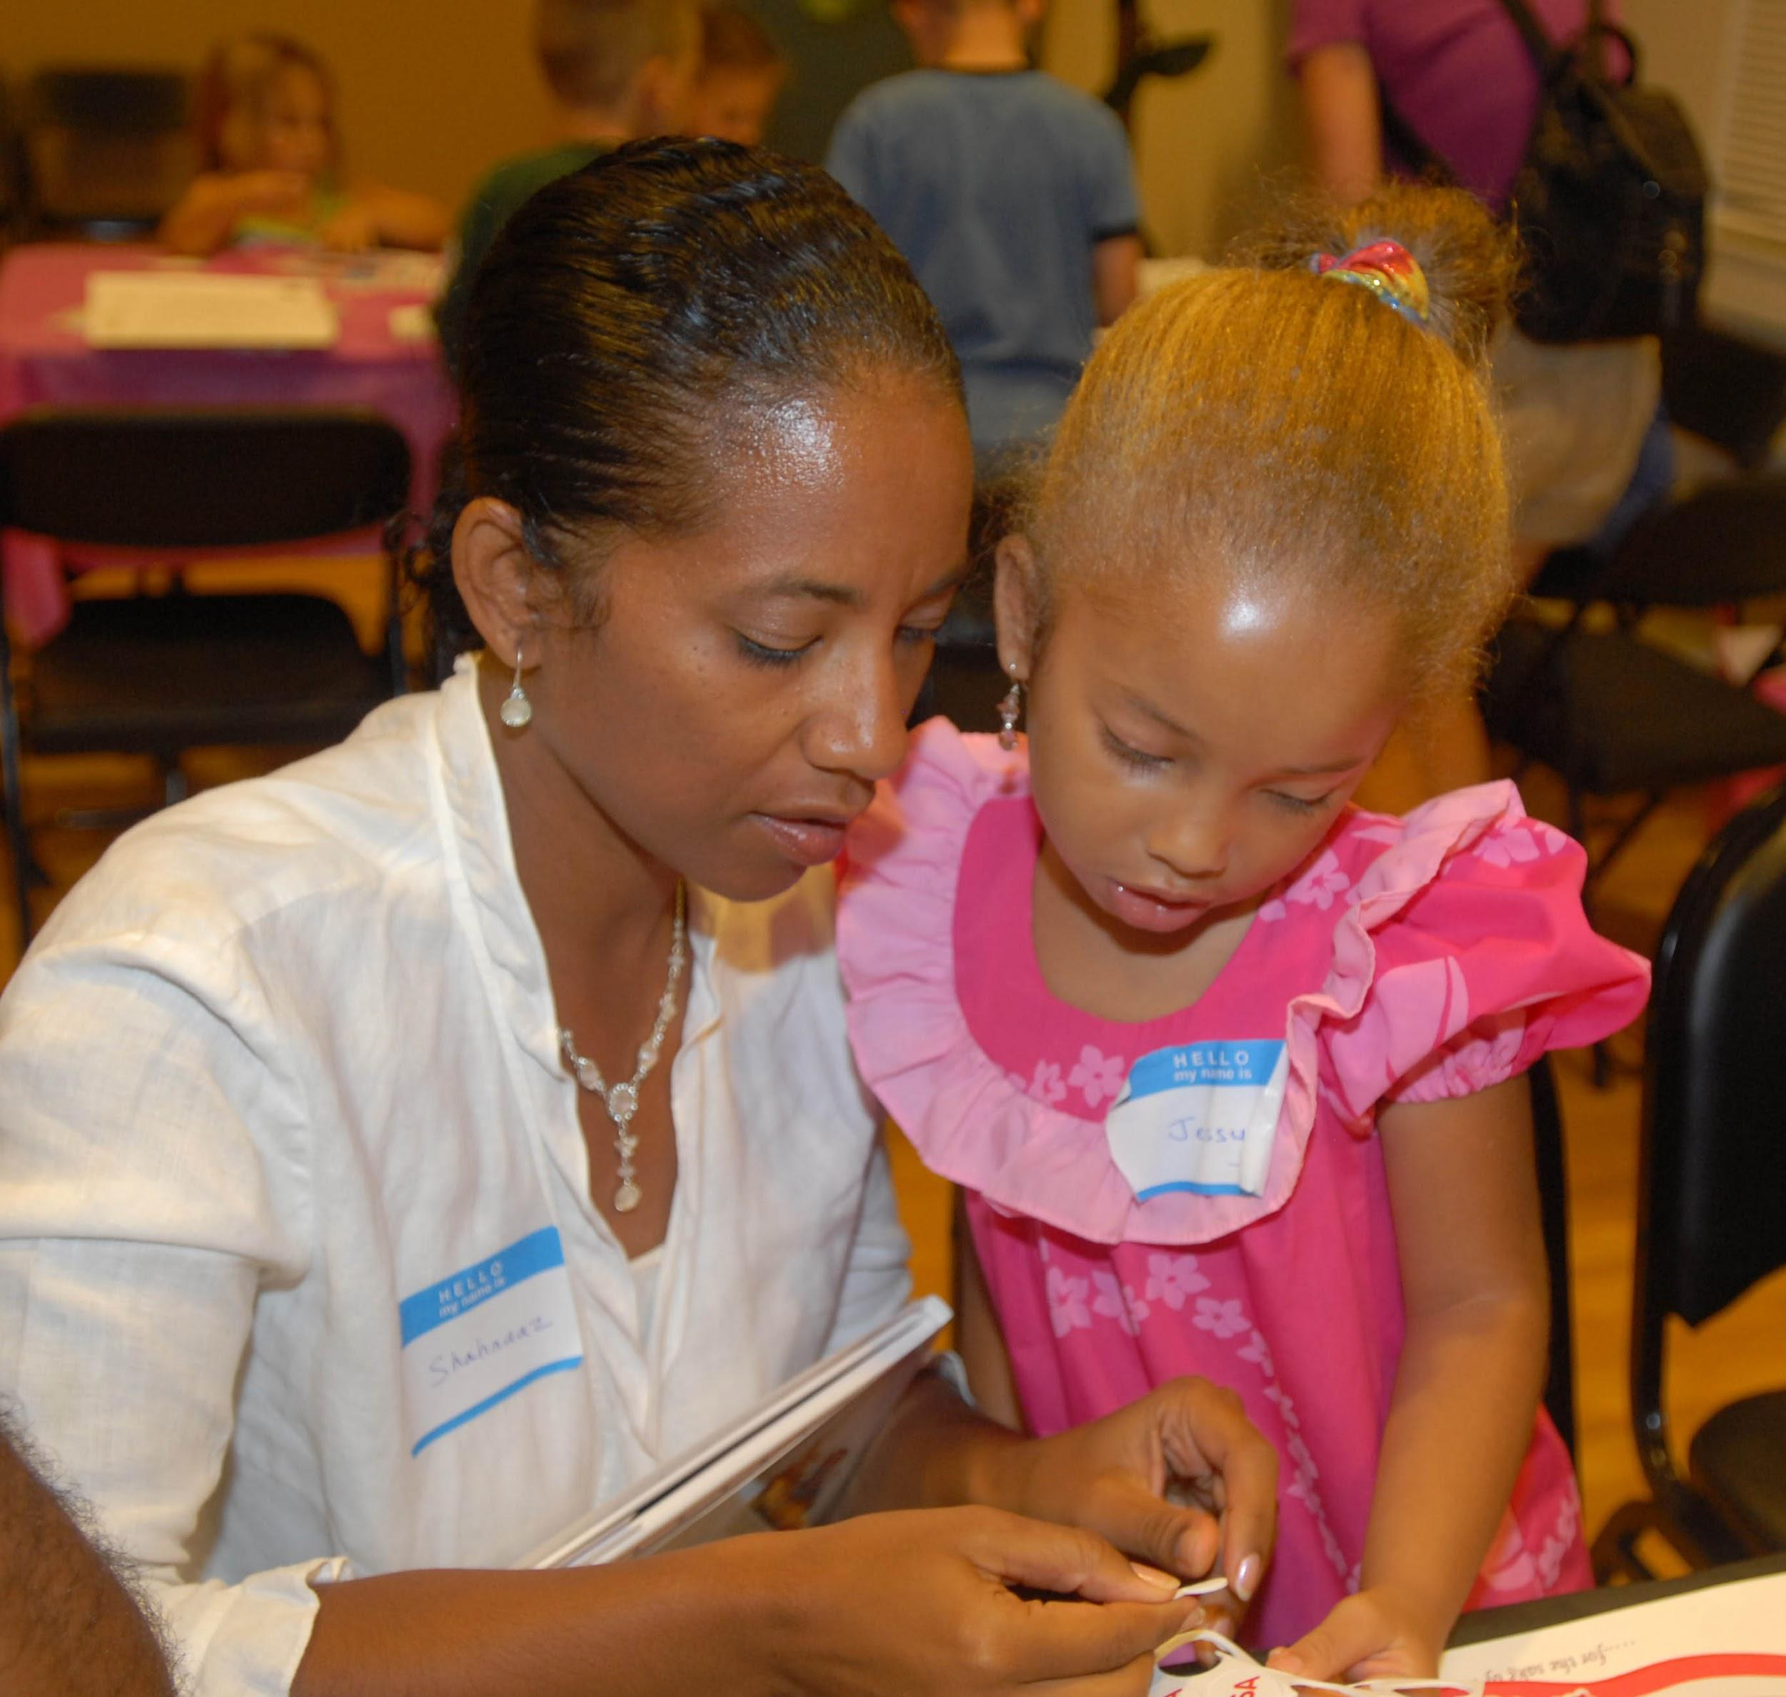
YOU Have the RIGHT to be INVOLVED, and WE SUPPORT that RIGHT!!!
Notes:
As a parent at (our school), it is important for you to be involved in your son or daughter’s education. You are welcome to contact our office for meetings with the teacher or principal,, come and volunteer in the classrooms, be a part of PTA. You can run for School Site Council and help make important decisions about how our school supports your children. If your child is an English Learner, you can join our ELAC committee so you can learn about our programs and have your voice heard.

Slide 8
Ways for Parents and Guardians to be involved in our school:
Be present at drop off and pick up times, and report any concerns to a staff member
Communicate with your child’s teacher
Attend events such as Coffee with the Principal and Science Night
Complete Parent Surveys and send them in on time
Participate in the PTA
Attend English Learner Advisory Committee (ELAC) meetings
Run for School Site Council
Make sure your child eats breakfast every day
Monitor your child’s progress, and let the teacher know if you have concerns
Take part in our Parental Involvement Policy revision process beginning in January, 2016

